Slide 1
Gale Presents: Udemy
Notes:
Use this slide to introduce yourself and the presentation.
Notes throughout this presentation provide instruction around areas to customize for your specific audience, as well as speaker notes to make the process of presenting easier. Feel free to hide slides and select what content to feature if you are given shorter speaking times, or if you’re able to take attendees live into Gale Presents: Udemy.

Slide 2
CONNECT PATRONS TO NEARLY 25,000 ON-DEMAND COURSES FOR IN-DEMAND SKILLS
Technology Skills
Data Science, Cloud Computing, Development
Business Skills
Leadership, Management, Communication
Personal Development
Health, Language Learning, Arts
AI (Artificial Intelligence)
Cloud Computing
Cybersecurity
IT
Adobe Products
Microsoft Suite
Marketing
Leadership
Communication Skills
Business Fundamentals
HR Processes
Entrepreneurship
Time Management
Photography
Yoga
Emotional Intelligence
Personal Finance
Drawing
Notes:
Full courses have been developed to support multiple key adult education categories including technological skills, business skills, and personal development. Patrons have the option to browse different categories using the Explore button next to the tool bar.

Slide 3
GALE PRESENTS: UDEMY QUICK FACTS
REGULAR UPDATES
60% of the collection and 63% of the technical courses have been updated in the last two years, ensuring learners are developing skills in the most relevant areas.
LEARNER-FIRST APPROACH
Sophisticated recommendations for engaged learning, with ratings and reviews from previous learners.
View what to learn next, newest courses, and what’s trending.
INTERNATIONAL COLLECTION
Thousands of courses in 14 languages taught by subject-matter experts in their native language.
Notes:
The 14 languages include Arabic, French, German, Hindi, Indonesian, Italian, Japanese, Korean, Mandarin, Polish, Portuguese, Russian, Spanish, and Turkish.

Slide 4
ACCESSING THE RESOURCE

Slide 5
GALE PRESENTS: UDEMY SIGN IN
1
2
Enter your library barcode or password to access the platform
Utilize the Sign In/Create a Udemy Account button to access your account
Notes:
To sign into Gale Presents: Udemy patrons will first need to sign into the platform in whatever way your library has authentication set (generally a barcode or password). Once they are signed onto the platform, they will then need to sign in (or create) their individual account. To enhance account security, patrons will need to complete a two-step authentication.
The first step of authentication requires patrons to either sign in with a Microsoft/Google account, or create an account with a username and password.
The second step of authentication is found on the next slide.

Slide 6
GALE PRESENTS: UDEMY SIGN IN
3
4
Create a Udemy username and password, or sign in with Google or Microsoft
Secondary authentication utilizing Okta Verify is required
Notes:
Once a patron signs in using their Google/Microsoft account, or by creating a username and password, they will be prompted to utilize Okta Verify to confirm their identity. They will be required to either enter an emailed code or utilize push authentication with their cell phone.

Slide 7
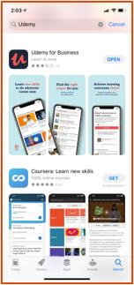
GALE PRESENTS: UDEMY MOBILE ACCESS
Search for “Udemy”
Make sure to choose Udemy for Business
Open the
Udemy for Business app
1
2
Notes:
Gale Presents: Udemy is mobile responsive, so it can be used on any device. To find the Udemy App patrons should search for Udemy and select the “Udemy for Business” app. There is another app entitled “Udemy Online Video Courses” which is not connected to Gale Presents: Udemy.

Slide 8
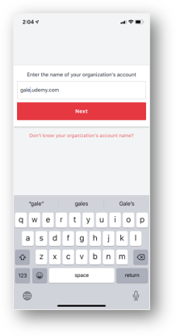
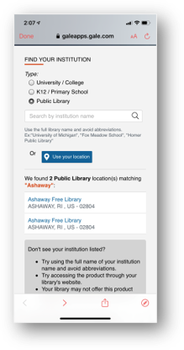
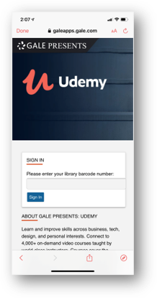
GALE PRESENTS: UDEMY MOBILE ACCESS
3
4
5
Enter “gale” as the name of your organization
You’ll be prompted to search for your library name
Enter your library barcode to authenticate
Then log in with your Google or Microsoft account
Notes:
Once patrons download the app, they will need to enter Gale as their organization, search for your library name, and authenticate the same way as if they were using a computer.

Slide 9
NAVIGATION AND DISCOVERY
Notes:
This section walks through how to utilize the platform to find content.

Slide 10
GALE PRESENTS: UDEMY HOMEPAGE
Browse and Search options to find new materials
Access current courses to continue previous sessions, and get stats about your progress
Find new courses with the What To Learn Next section. Suggestions are based on course and search history
10
Notes:
The homepage allows users to both browse and search for content they are interested in. They will also be able to see the courses they are completing under the “Pick up where you left off” section.

Slide 11
GALE PRESENTS: UDEMY BROWSING
Explore and Categories listed on the homepage are a great starting point for those not sure what to look for
Explore opens a step-by-step guide to targeted topics
Notes:
The Explore button and Categories options at the top of the homepage allow patrons to browse without having to run a search. Selecting Explore leads them to a drop down in which they can narrow their results.

Slide 12
GALE PRESENTS: UDEMY SEARCH RESULTS PAGE
Filters guide users to the content they need based on language, ratings, topics, and course features
Search results are organized based on relevancy, and provide a basic description with course duration
Notes:
Search results pages include key filers on the left including language, rating, features, topics, and level.

Slide 13
GALE PRESENTS: UDEMY INTERNATIONAL COLLECTION
The best way to find classes in different languages is to use the Language Filter that appears on results pages.
Notes:
Users coming to your library looking for courses in different languages can utilize the Language filter on the left side of the page. The default is to show all languages in results.

Slide 14
GALE PRESENTS: UDEMY BADGE BROWSE
Found under the Explore button, badges allow you to find content relevant to specific certifications
Select a badge to be launched into prep courses
Note: Selecting a badge also provides a link to register for certification
Filter based on certificate issuer or subject area
Notes:
Badges are utilized to identify which courses support various certifications. Patrons can browse through the badges, and badges will be visible on any course entry they are attached to.

Slide 15
GALE PRESENTS: UDEMY BADGE PAGE
More detailed information about certification, as well as certification registration link
List of courses related to badge and certification
Notes:
While on a badging page, patrons will get additional information on the certification. They will also have access to a link that will allow them to schedule a certification test. Courses attached to a badge will appear at the bottom of the page.

Slide 16
ENROLLING AND TAKING COURSES
Notes:
This section walks through how to enroll and complete courses.

Slide 17
GALE PRESENTS: UDEMY COURSE PAGE
Details on certifications (if applicable)
Course enrollment section, including the option to preview the course, and a detailed list of included materials and features
In-depth description including key learning areas and course requirements
17
Notes:
When patrons select a course, they will be taken to the course page. Here they will find more detailed information to ensure the course meets their needs. Patrons will also be able to see if there are any prerequisites or materials needed. To enroll in a course they will need to select the purple Enroll Now.

Slide 18
GALE PRESENTS: UDEMY COURSE PAGE
Course video player with transcript and captions available
Course content including video durations
Additional descriptive course materials including learning outcomes, instructor information, reviews, and requirements
18
Notes:
Once enrolled in a course, patrons will see the course player on the left, and the course progression on the right. As they finish sections they will see them appear as completed. Patrons can skip or go back through a course as needed.

Slide 19
?
…
Notes:
Use this slide as a visual prompt for final questions and/or discussions. If you have the time, try to access Gale Presents: Udemy and provide a walkthrough before questions.

